Slide 1

LeARn

Slide 2

WHAT IS OUR IDEA?

Slide 3
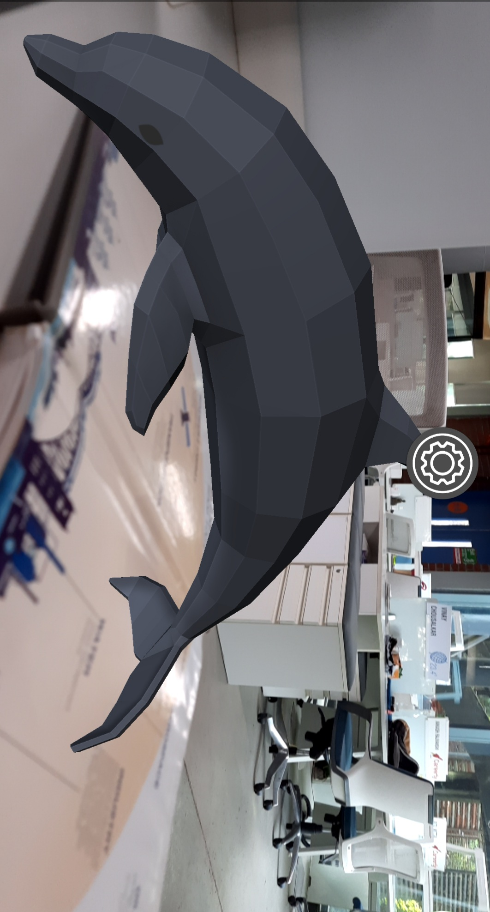
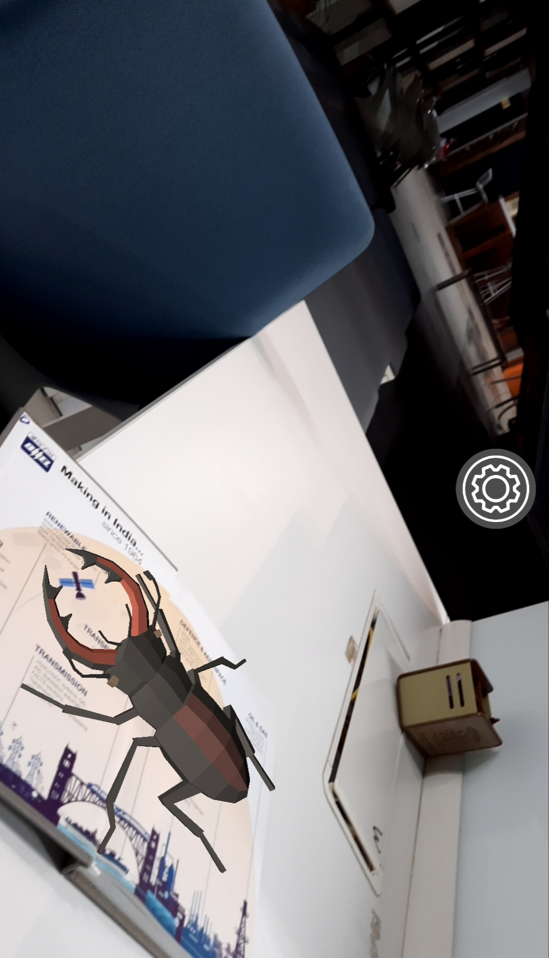
OUR TECHNOLOGY

Slide 4

WHAT IS UNIQUE IN US?

Slide 5


WHAT ARE THE BENEFITS?

Slide 6
FEATURES INVOKED

Slide 7

FINAL OUTPUT
LeARn

Slide 8
THANK YOU
Team Details:
Kaushik Apoori
Ashish Goskula
V. Aadarsh Mahendra
Abhishek Purumandla

